Slide 1
Power Platform, Less Code-More Power
@elbruno
In-person event

Slide 2


What we will cover:
Understanding what power platform is and its value
Walkthrough the different power platform tools
Power Platform in Action
Next Steps and Resources

Slide 3

Power Platform
Empowering everyone in your organization to craft solutions without writing a single line of code.
Comprises a family of applications to help you – automate process, analyze data, build apps and chatbots

Slide 4

Anyone can be a developer with Power Platform

Slide 5
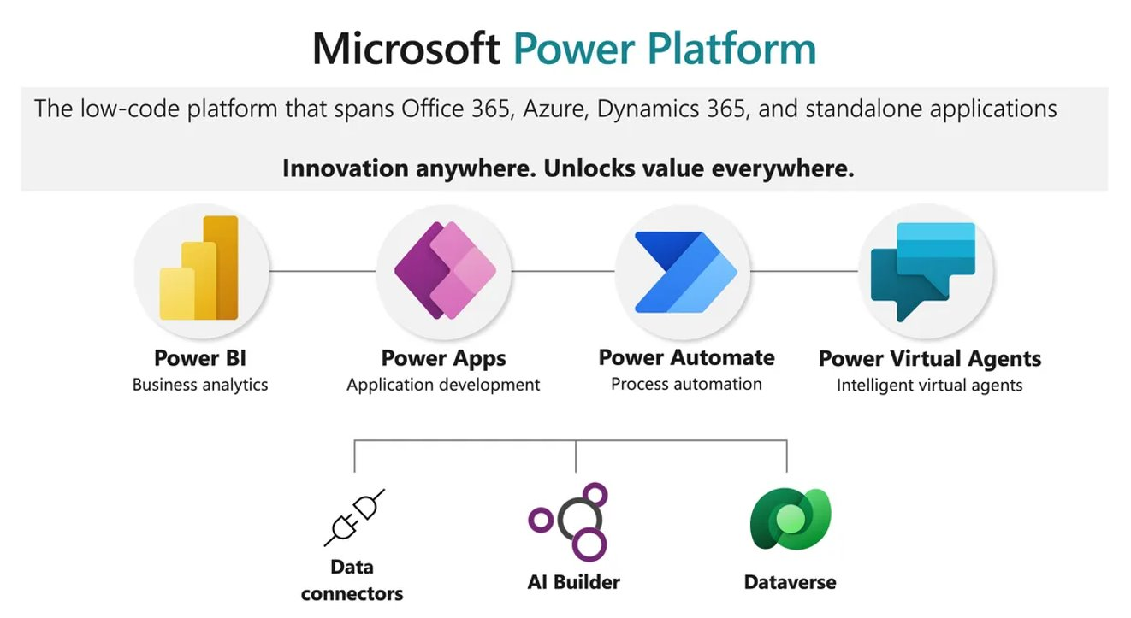

Slide 6

Power Apps
Build low-code solutions to business challenges.
It has services, connectors, a scalable data service and app platform to allow simple integration and interaction with existing data.
Power Apps enables the creation of web and mobile applications that run on all devices.

Slide 7

Power Automate
It automates time-consuming tasks and create workflows between applications
Don’t waste important productive hours drafting the same email for a weekly update.
Streamline processes with no code automation.

Slide 8

Power BI (Business Intelligence)
An analytics service that delivers insights for analyzing data.
It can share those insights through data visualizations which make up reports and dashboards to enable fast, informed decisions.
It takes business data and allows you to display it in ways that makes the most sense to users.

Slide 9

Power Virtual Agents
Create powerful chatbots using a guided, no-code graphical interface, without the need for data scientists or developers.
Empowers subject matter experts to build and maintain their own conversational solutions
Can be linked to other Power Platform services such as Power Automate.

Slide 10
Other Exciting Features:
AI Builder: add AI capabilities to your flows and apps
Dataverse: lets you securely store and manage data from multiple sources and integrate with your applications
Connectors: connect apps, data and devices in the cloud. For example, Twitter, Dropbox etc.

Slide 11

Value of Power Platform

Slide 12

Power Platform Use Cases
Schedule announcements or messages in Teams ​
Onboarding process – power app for new students
Feedback – automate and analyze data
Registration process​

Slide 13

Power Platform in Action

Slide 14
What we have covered:
What power platform is and its value
Walkthrough the different power platform tools
Power Platform in Action

Slide 15

Resources and Next Steps
Explore Power Platform and more at https://aka.ms/learnstudent ​
Join the Microsoft Learn Student Ambassador Community at https://aka.ms/studentambassadors ​

Slide 16
Next steps
Resources from today!
Microsoft-Build-Student-Developer-Drop-in-day Resources
Student Hub
https://aka.ms/learnstudent
Cloud Skills Challenge https://aka.ms/StudentDeveloperDayChallenge

Slide 17
Thank You!
@elbruno
In-person event

